Slide 1
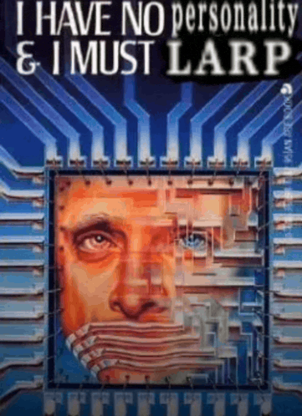
Larping 101
By lead larper

Slide 2
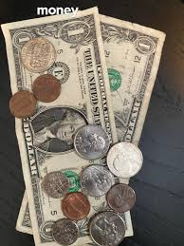
What is larping?
Being performative. Perhaps even living an unattainable lifestyle

Slide 3
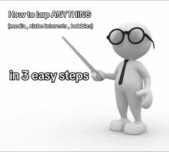
How does one larp?
By participating in CTF@CIT 2026 you are basically larping so ummmm yeah...

Slide 4


The end

